Slide 1
Ada boosting algorithm
By sharan

Slide 2
AdaBoost: The Foundation of Boosting
Definition: AdaBoost (Adaptive Boosting) is the first successful sequential
ensemble learning algorithm, introduced by Freund and Schapire.
Goal: To convert a set of many weak learners (classifiers that are slightly better than random,
e.g., Decision Stumps) into a single, highly accurate strong learner.
Core Principle: Iterative Correction – Each new weak learner is trained specifically
to fix the errors made by the previous ones.

Slide 3
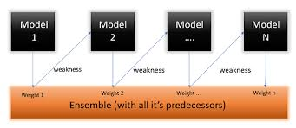
Visula aid

Slide 4
AdaBoost Working Mechanism (Weights)
Data Sample Weights: The key mechanism is the management of sample weights.
Initialization: All training samples start with equal weight (1/N).
Iteration: After training a weak classifier (hm), the algorithm checks the results:
Misclassified Samples: The weights of these samples are increased.
Correctly Classified Samples: The weights of these samples are decreased.
Next Model Focus: The next weak classifier focuses its training disproportionately on the
higher-weighted (previously misclassified) samples.
Weak Classifier Weight (alpha): The weak classifier itself is assigned a weight based on its accuracy.
More accurate classifiers get a higher weight in the final voting ensemble.

Slide 5
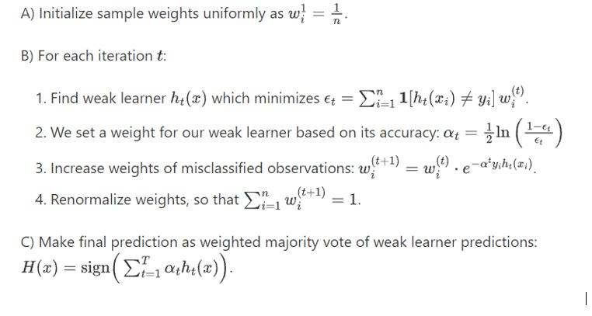

Slide 6
Pros & Cons:
Pros: Simple, fast, often very effective.
Cons: Highly sensitive to noisy data and outliers (as it aggressively focuses on these hard-to-classify points).

Slide 7
conclution
Vulnerability to Noise: Because AdaBoost repeatedly focuses on misclassified samples by increasing their weights, outliers or mislabelled data can consume significant resources, leading to overfitting and poor generalization.
No Parallelism: The sequential nature of the algorithm makes it inherently non-parallelizable in its core training loop.
Model Type: Primarily designed for classification (specifically binary), though extensions for regression exist

